Slide 1
The FRPS Evaluation Tool: Getting Started
Presented by the fall river educators’ association

Slide 2
Background Information
In 2011, the Board of Elementary and Secondary Education adopted new regulations for the evaluation of all Massachusetts educators.
The purpose was to provide educators with a continuous opportunity for professional growth and development.

Slide 3
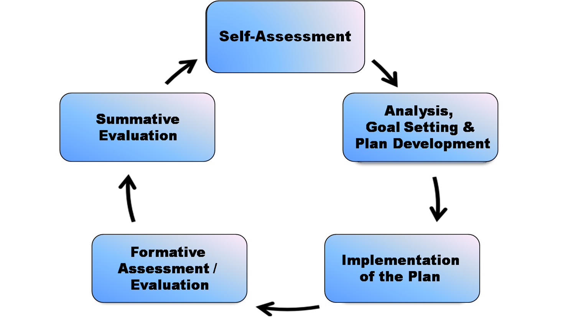
The Evaluation Process is a 5-step cycle

Slide 4
Rubrics are used throughout the 5-step cycle
The Teacher Rubric is for all teachers, including teachers of whole classrooms, small groups, individual students, general education teachers, teachers with specialized classes or knowledge, including teachers of English Language Learners, and special education teachers.
The Specialized Instructional Support Personnel Rubric is for educators in professional support roles such as school counselors, school psychologists, school nurses.
They both include 4 standards:
Standard I: Curriculum, Planning, and Assessment | Standard II: Teaching All Students | Standard III: Family and Community Engagement | Standard IV: Professional Culture

Slide 5
Step 1: SELF-ASSESSMENT
Analysis of Evidence of Student Learning, Growth and Achievement
Assessment of Practice Against Performance Standards

Slide 6
Step 2: GOAL SETTING
Minimum of 2 goals:
Professional Practice
Student Learning
Team Goals are encouraged
First year teachers must include induction and mentoring activities
Evaluator should work with new teachers to propose goals

Slide 7
S.M.A.R.T GOALS
S = Specific and Strategic
M = Measurable
A = Action Oriented
R = Rigorous, Realistic, and Results Focused (the 3 Rs)
T = Timed and Tracked

Slide 8
Step 3: PLAN DEVELOPMENT
Educators without professional status = DEVELOPING PLANS
Educator must have a plan to attain each goal.
Educator submits plan to evaluator for approval
Plan should identify actions, resources, timelines and evidence of success.

Slide 9
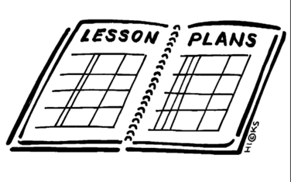
Educators and Evaluators Collect Evidence
Educators collect artifacts for each of the 4 standards in the rubric and for each goal
Observations are evidence
Work with your evaluator to determine the evidence they need
Quality over quantity
This Photo by Unknown Author is licensed under CC BY-NC

Slide 10
Advice for Handling Evaluation
Communicate regularly with your evaluator
Know the process and the expectations (in the back of the FREA Contract)
Don’t be afraid to make mistakes
Be reflective and open to feedback
Don’t let it distract you from the work- stay focused on the kids!
STAY CALM!

